Slide 1
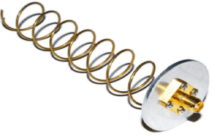
Helical Antenna
Presented By
Sapna M Jaganure(2gi20ec419)
Shivani S Pujeri(2gi20ec422)
Snehal S Kanbargi(2gi20ec424)

Slide 2
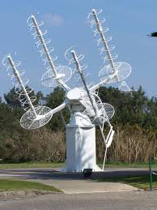
Introduction
The simplest antennas which are used widely in ultra-high frequencies are known as helical antennas, so this antenna works in VHF & UHF ranges. These antennas are designed with conducting wire in a helix shape. This antenna has some unique characteristics like wide bandwidth, high gain & circular polarization.
The frequency range of this antenna ranges from 30MHz-3GHz. This antenna is used in space communication such as satellite relays and also in radio astronomy, wireless networking & satellite communication.

Slide 3
Features
This is a simple antenna used for circular polarization.
It is utilized in different bands like VHF &UHF.
It is most commonly used in axial mode.
It is not chosen in normal mode where efficiency and beamwidth are small in this mode.
Its design is very simple & has maximum directivity.
In axial mode, it is a wideband antenna.
If the axial ratio is zero then, linear horizontal polarization occurs.
If the axial ratio is infinite then linear vertical polarization occurs.
If the axial ratio is one, then circular polarization occurs.

Slide 4
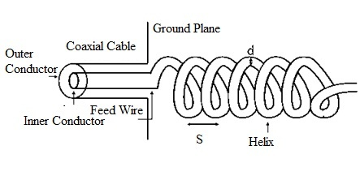
Design of Helical Antenna
The construction of the helical antenna is shown below. This antenna can be designed with a conducting wire-like thick copper wire wounded in helical form & it is connected to the ground plate through a feeder line. This antenna is very simple to design and it provides waves that are polarized circularly, so it is used in different communication-based applications where satellite relays are involved.

Slide 5

Pitch angle is the angle between a line tangent to the helix wire and plane normal to the helix axis.
where,
D is the diameter of helix.
S is the turn spacing (centre to centre).
α is the pitch angle.

Slide 6
Working
Once a conductive wire in an antenna is excited through a coaxial cable otherwise two-wire transmission line then-current supplies throughout the conducting wire. So, this causes the field lines generation & emission of radiations. It is important to know that a helical antenna may emit in different modes, so modes of operation of the helical antenna are normal mode and axial mode.

Slide 7
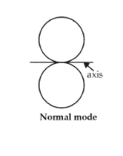
Normal Mode
In this type mode, both the pitch & the diameter of the helix antenna are tiny as compared to the wavelength. So, its operation is analogous to an electrical short dipole or monopole. In radiation of normal mode, the field of radiation is normal to the helix axis so, radiated signals are polarized circularly.
This mode has low efficiency & narrow bandwidth, so used mainly for compact antennas for portable, two-way mobile radios & UHF TV broadcasting antennas. The helical antenna’s radiation pattern is a combination of both the loop & short dipole antennas.

Slide 8
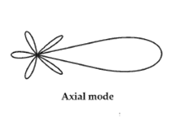
Axial Mode
In this mode, both the pitch and diameter of the helix antenna are similar to the wavelength, so it works like a directional antenna. Not like the normal mode, there is no simple solution available to decide the radiation properties in this axial mode. Thus for this mode, experimentally determined analytical & numerical methods are used to conclude these factors. This mode is frequently used through earth-based stations within satellite communications systems. This mode of operation is used more practically.

Slide 9
Advantages
Design is simple.
Directivity is high.
Wide bandwidth.
Circular polarization can be obtained.
It can be used at VHF and HF bands.
Robust construction.
When it uses a circularly polarized pattern then it is acceptable through both vertical & horizontal polarized antenna types.

Slide 10
Disadvantages
Its size is larger so occupies more space.
The efficiency mainly depends on the number of turns so, because of the number of turns, the efficiency will be decreased.
High cost.

Slide 11
Applications
These antennas are applicable in satellite & space probe communications because of their circular polarization of the transmitted electromagnetic waves & maximum directivity.
A single or array of helical antennas are used for transmitting & receiving VHF signals.
Used for satellites at Earth stations.
Used for telemetry links through ballistic missiles.
Communication can be established between the moon & the earth.
Helical antennas are used in many satellites like data relay and weather.
This antenna is used for transmitting & receiving VHF waves, especially for ionospheric propagation.
It is used for different communications like radio astronomy, space telemetry, satellite, and space.

